Slide 1

Biodiversity patterns and how they emerge
Petr Keil
Notes:
Hi, my name is Petr Keil and this is my project Biodiversity dynamics across a continuum of space, time, and their scales.

Slide 2
Latitudinal gradients of biodiversity
From the tropics towards the poles
Notes:
I am qualified to deliver all this

Slide 3
Latitudinal gradient
Birds across the New World (grid cells of ~ 611,000 km²)
Storch & Gaston (2004) Basic and Applied Ecology
Notes:
In this panel we can probably all agree that biodiversity is one of the most valuable natural resources.
But things like climate change or habitat loss are a threat to biodiversity, to the extent that we hear about biodiversity crisis, or sixth mass extinction
For example, about 1% of vertebrate species have gone extinct because of humans

Slide 4
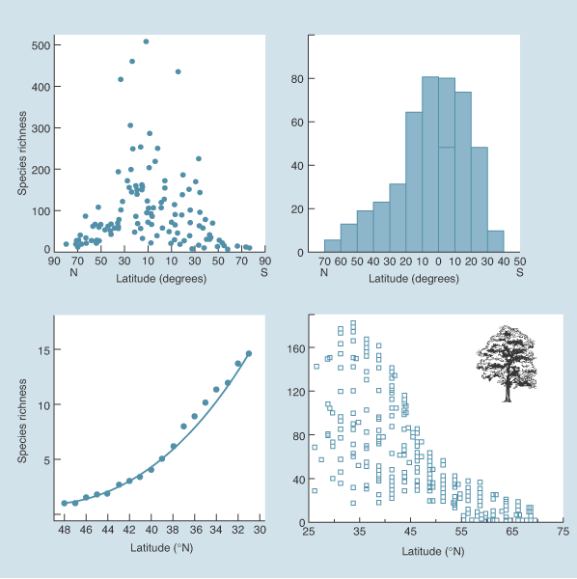
Latitudinal gradient
marine bivalves
butterflies
US lizards
trees
Begon et al. (2004) Ecology (the textbook)
Notes:
In this panel we can probably all agree that biodiversity is one of the most valuable natural resources.
But things like climate change or habitat loss are a threat to biodiversity, to the extent that we hear about biodiversity crisis, or sixth mass extinction
For example, about 1% of vertebrate species have gone extinct because of humans

Slide 5
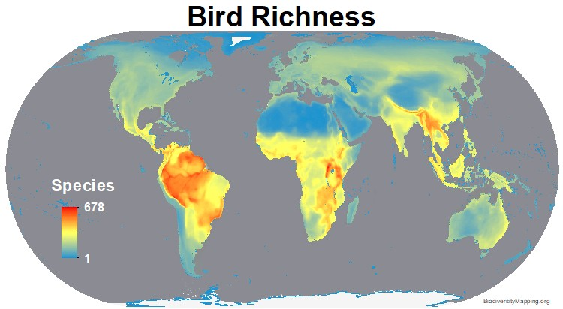
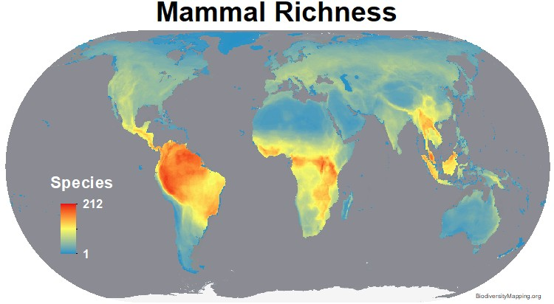
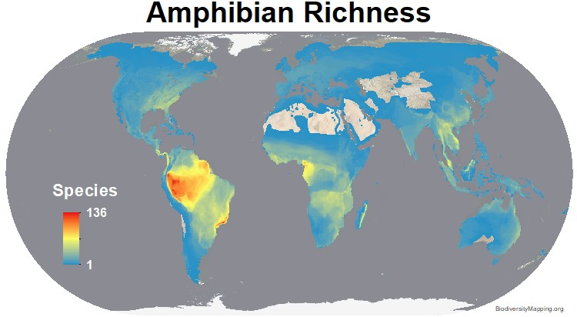
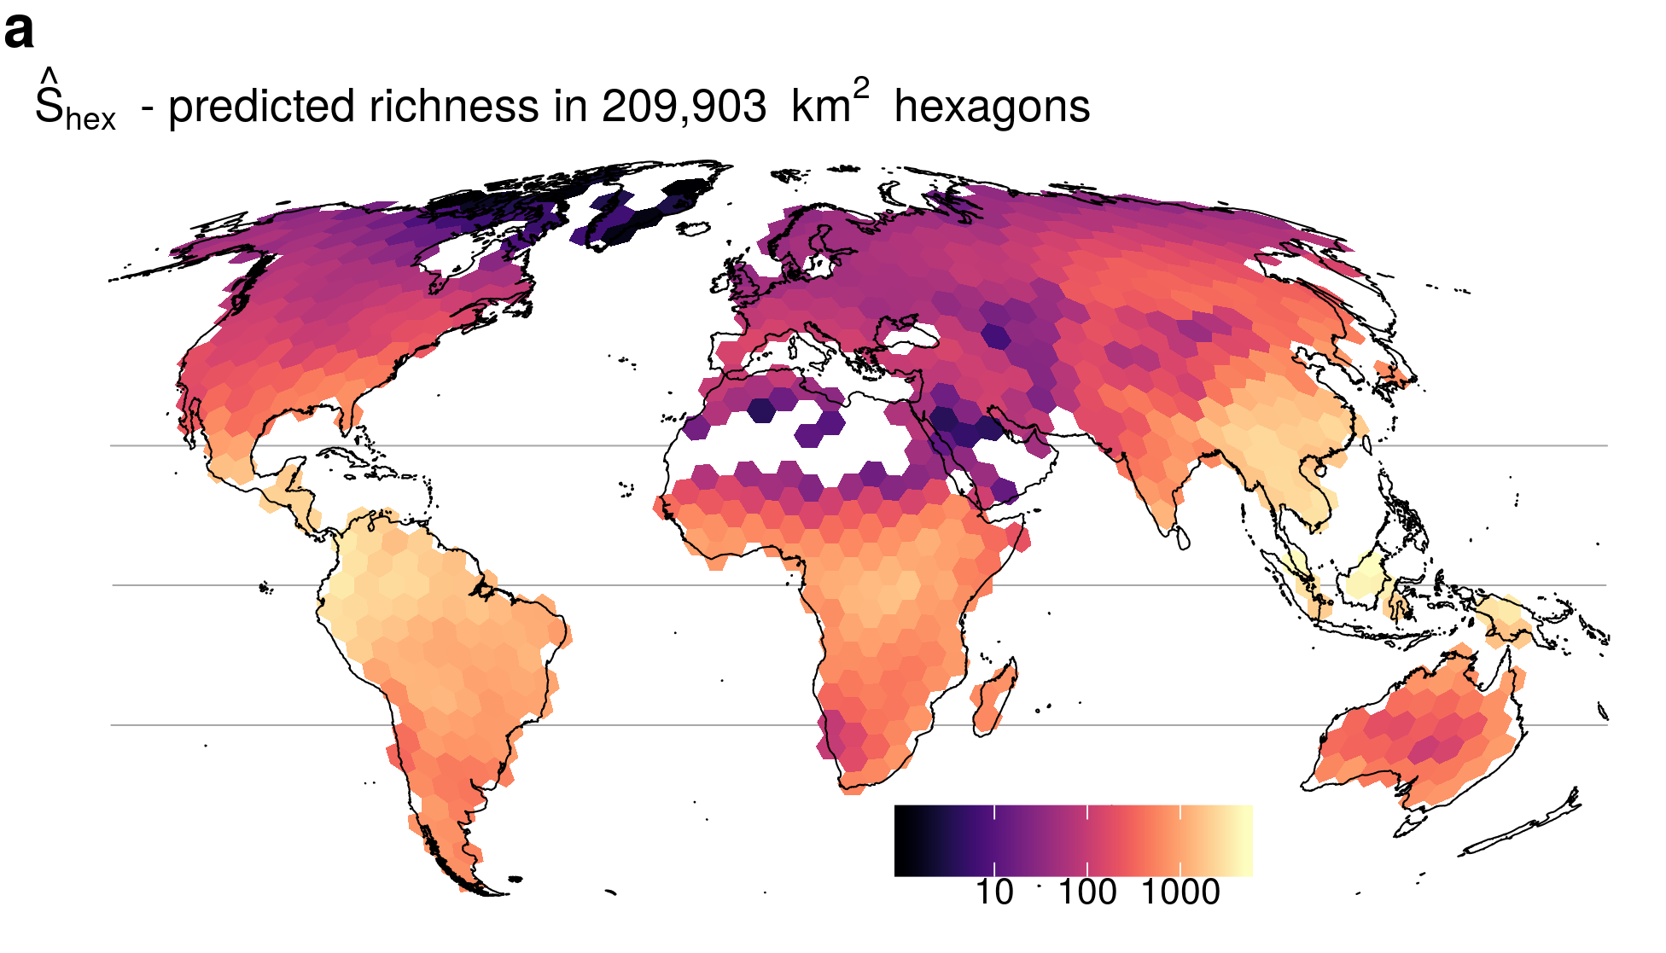
Latitudinal gradient
Tree Richness
BiodiversityMapping.org; Keil & Chase (2019) Nature Communications
Notes:
In this panel we can probably all agree that biodiversity is one of the most valuable natural resources.
But things like climate change or habitat loss are a threat to biodiversity, to the extent that we hear about biodiversity crisis, or sixth mass extinction
For example, about 1% of vertebrate species have gone extinct because of humans

Slide 6
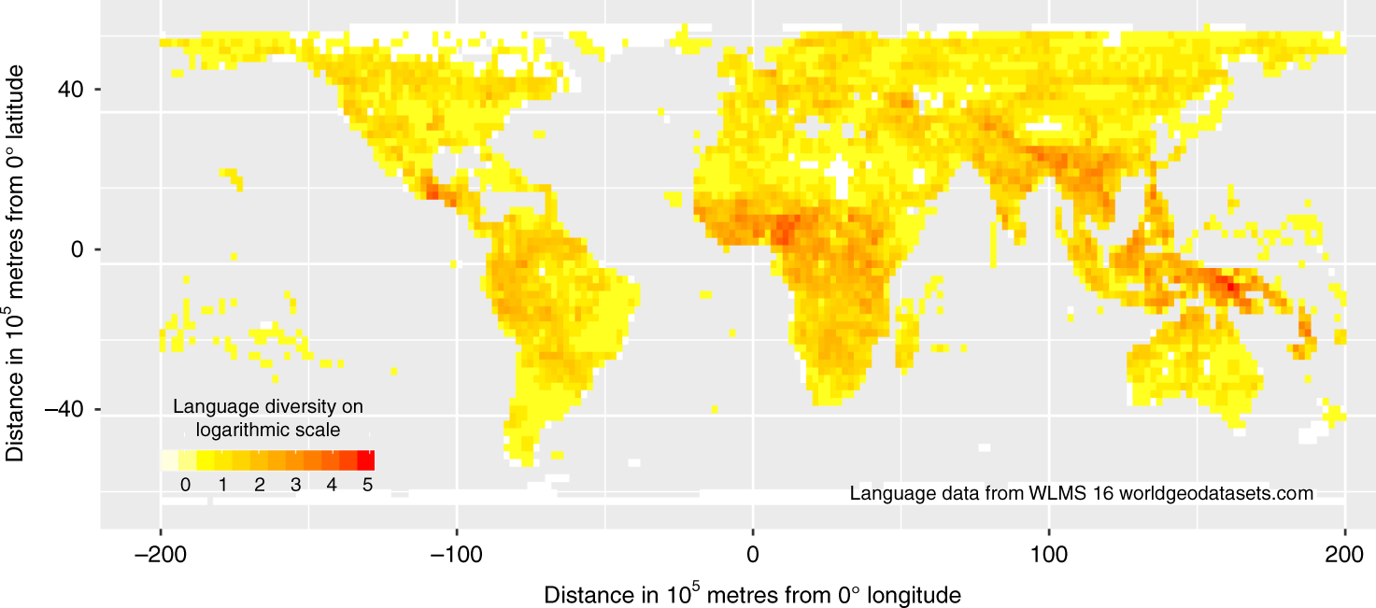
Also holds for languages
Mace & Pagel (1995) Proc R Soc B
Hua et al. (2019) Nature Communications
Notes:
In this panel we can probably all agree that biodiversity is one of the most valuable natural resources.
But things like climate change or habitat loss are a threat to biodiversity, to the extent that we hear about biodiversity crisis, or sixth mass extinction
For example, about 1% of vertebrate species have gone extinct because of humans

Slide 7
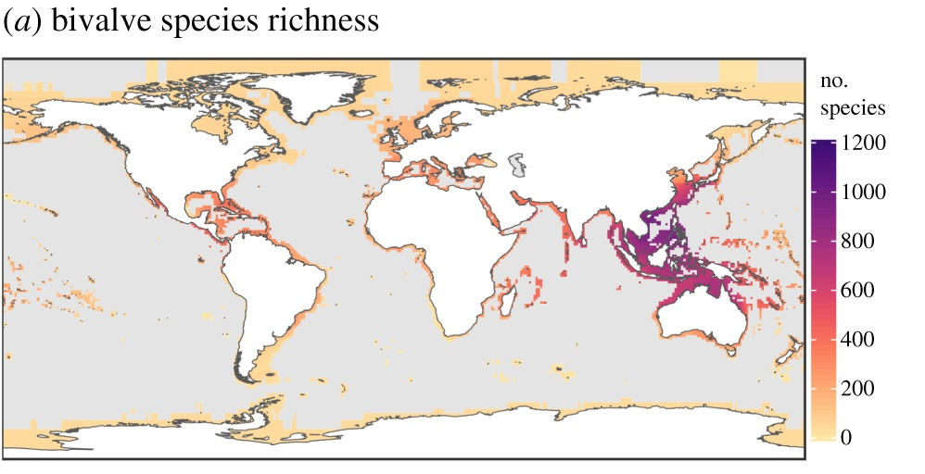
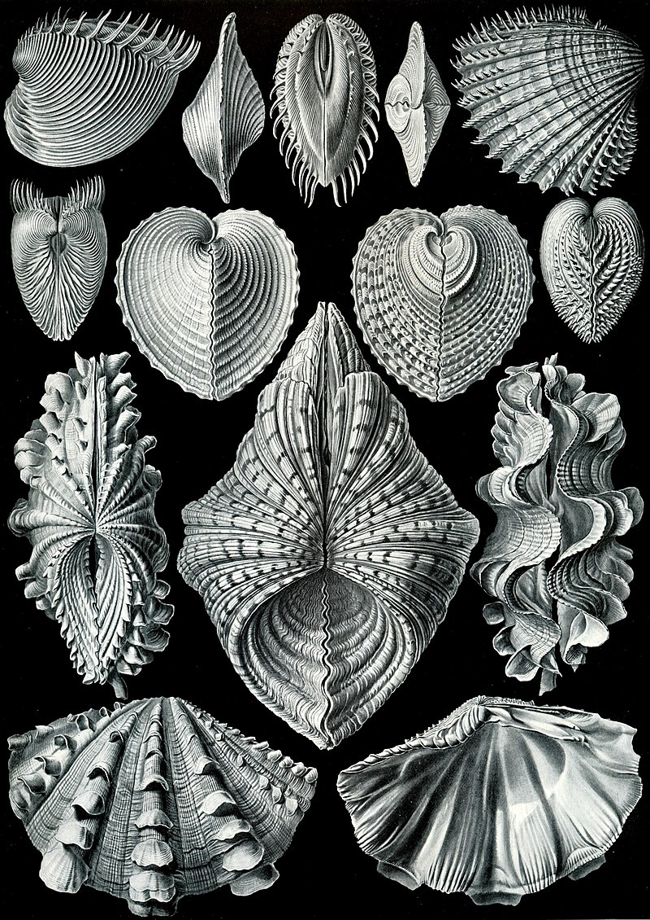
Latitudinal gradient in the sea
Schumm et al. (2019) Proc R Soc B
Notes:
In this panel we can probably all agree that biodiversity is one of the most valuable natural resources.
But things like climate change or habitat loss are a threat to biodiversity, to the extent that we hear about biodiversity crisis, or sixth mass extinction
For example, about 1% of vertebrate species have gone extinct because of humans

Slide 8
Exceptions and irregularities …
Keil & Chase (2019) Nature Ecology & Evolution
Notes:
In this panel we can probably all agree that biodiversity is one of the most valuable natural resources.
But things like climate change or habitat loss are a threat to biodiversity, to the extent that we hear about biodiversity crisis, or sixth mass extinction
For example, about 1% of vertebrate species have gone extinct because of humans

Slide 9
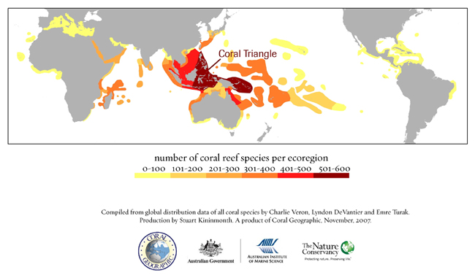
Exceptions and irregularities …
Notes:
In this panel we can probably all agree that biodiversity is one of the most valuable natural resources.
But things like climate change or habitat loss are a threat to biodiversity, to the extent that we hear about biodiversity crisis, or sixth mass extinction
For example, about 1% of vertebrate species have gone extinct because of humans

Slide 10
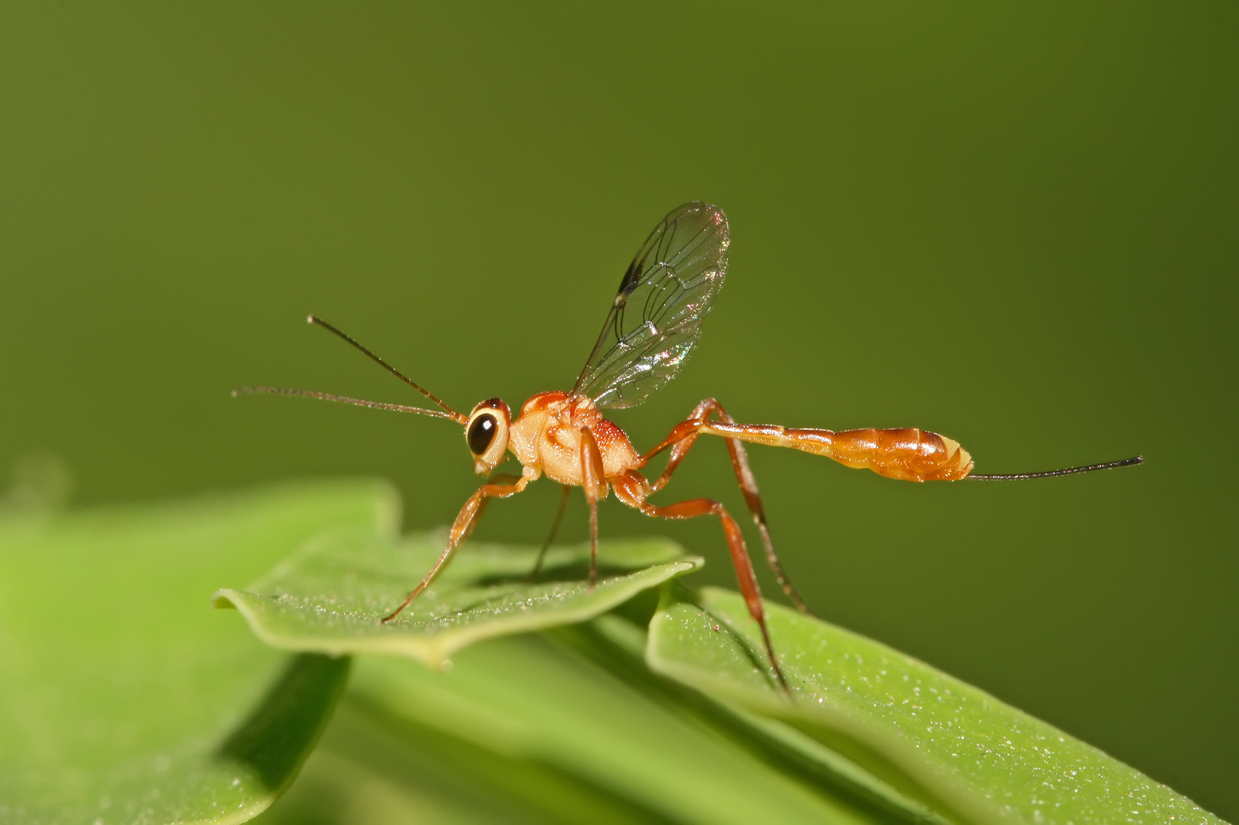
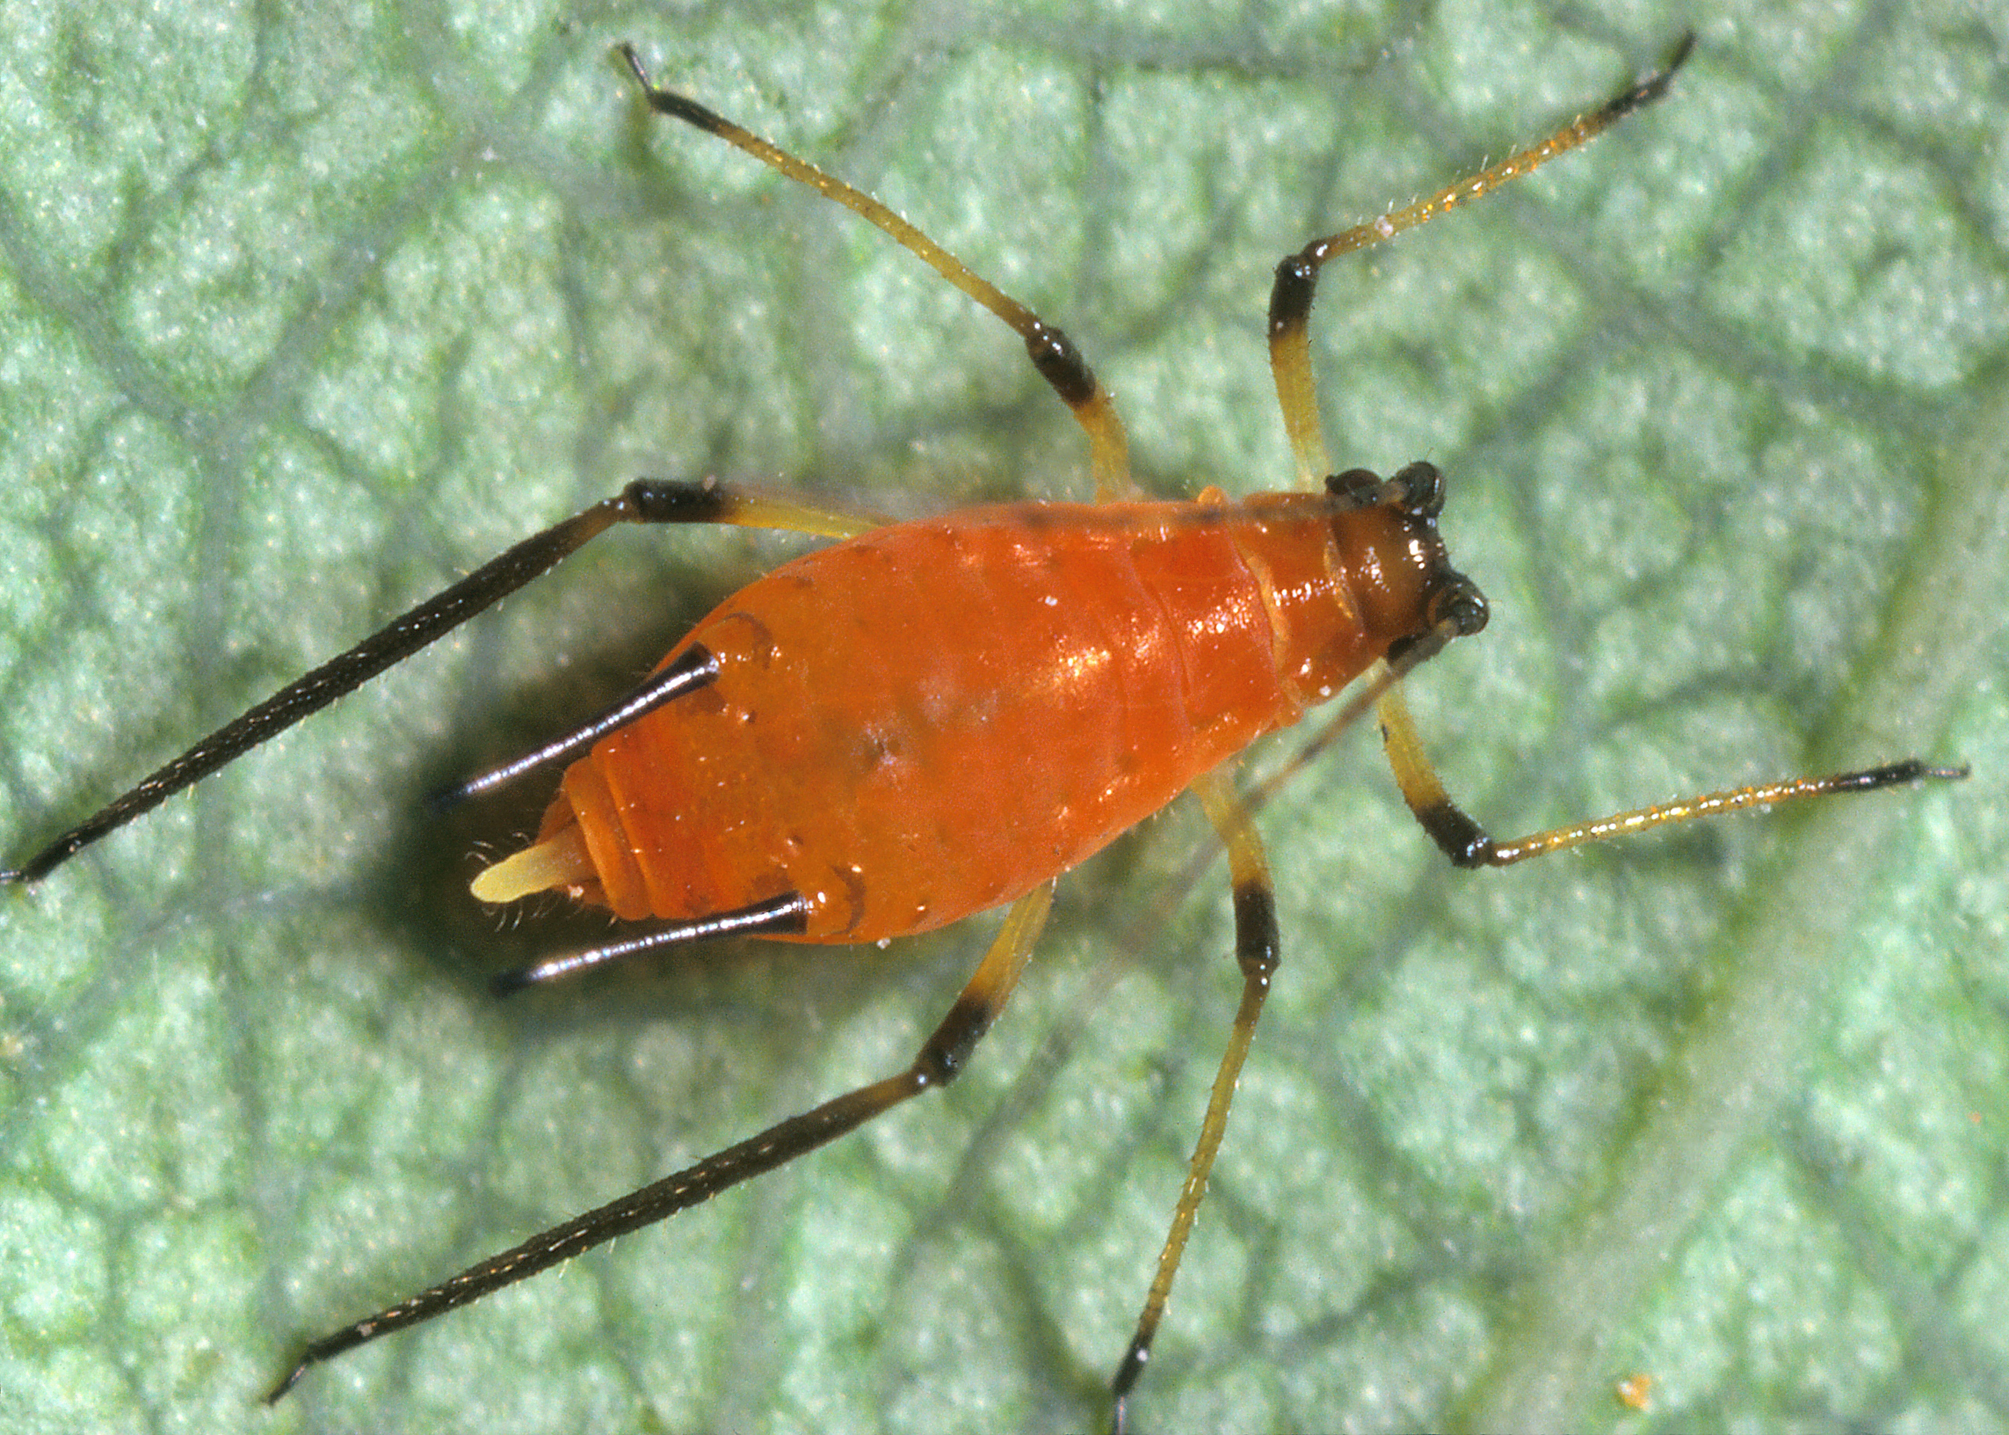
There area alco inverse latitudinal gradients (lower richness in the tropics)
Ichneumonids
Aphids
Marine benthic algae
Pitcher platn mosquito
Shallow-water molluscs
Kindlmann et al. (2005) Chapter in “Scaling Biodiveristy” by Storch et al.
Notes:
In this panel we can probably all agree that biodiversity is one of the most valuable natural resources.
But things like climate change or habitat loss are a threat to biodiversity, to the extent that we hear about biodiversity crisis, or sixth mass extinction
For example, about 1% of vertebrate species have gone extinct because of humans

Slide 11
Explaining the latitudinal gradient
There is > 30 hypotheses
Notes:
I am qualified to deliver all this

Slide 12
1. Geometry, statistics, mathematics
Perhaps there is nothing biological about biodiversity patterns
Notes:
I am qualified to deliver all this

Slide 13
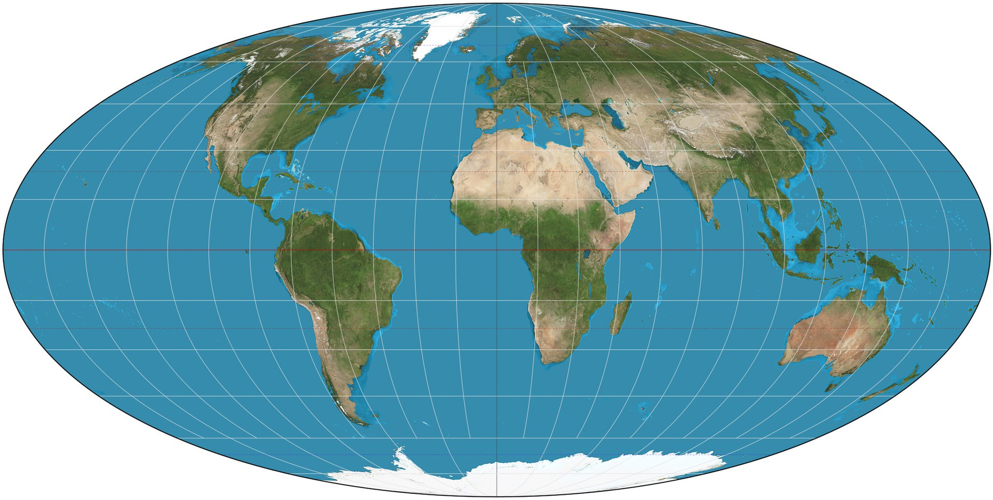
The tropics are bigger… or, are they really?
Rosenzweig (1995) Species Diversity in Space and Time
Rohde (1997) Oikos
Notes:
In this panel we can probably all agree that biodiversity is one of the most valuable natural resources.
But things like climate change or habitat loss are a threat to biodiversity, to the extent that we hear about biodiversity crisis, or sixth mass extinction
For example, about 1% of vertebrate species have gone extinct because of humans

Slide 14
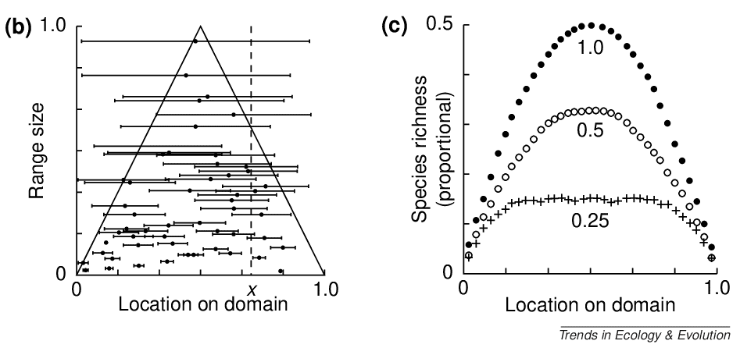
The mid-domain effect
The increasing overlap of species ranges towards the centre of a shared geographic domain due to geometric boundary constraints in relation to the distribution of species' range sizes and midpoints.
Colwell & Lees (2000) Trends in Ecology & Evolution
Notes:
In this panel we can probably all agree that biodiversity is one of the most valuable natural resources.
But things like climate change or habitat loss are a threat to biodiversity, to the extent that we hear about biodiversity crisis, or sixth mass extinction
For example, about 1% of vertebrate species have gone extinct because of humans

Slide 15
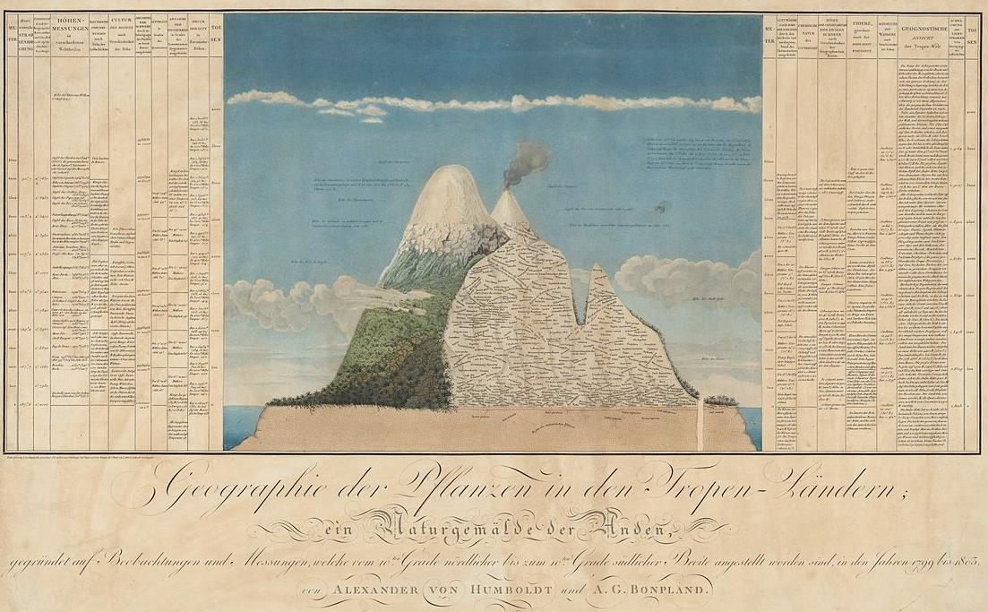
Elevational gradient of species richness
Rahbek (1995) Ecography
Notes:
In this panel we can probably all agree that biodiversity is one of the most valuable natural resources.
But things like climate change or habitat loss are a threat to biodiversity, to the extent that we hear about biodiversity crisis, or sixth mass extinction
For example, about 1% of vertebrate species have gone extinct because of humans

Slide 16
The mid domain effect in two dimensions – the spreading dye model
The best model combines the geometric mid-domain effect with climatic effects, specifically actual evapotranspiration (AET).
Storch et al. (2006) Ecology Letters
Notes:
In this panel we can probably all agree that biodiversity is one of the most valuable natural resources.
But things like climate change or habitat loss are a threat to biodiversity, to the extent that we hear about biodiversity crisis, or sixth mass extinction
For example, about 1% of vertebrate species have gone extinct because of humans

Slide 17
2. Climate
Is it warm, wet, productive, or stable climate that generates high biodiversity?
Notes:
I am qualified to deliver all this

Slide 18
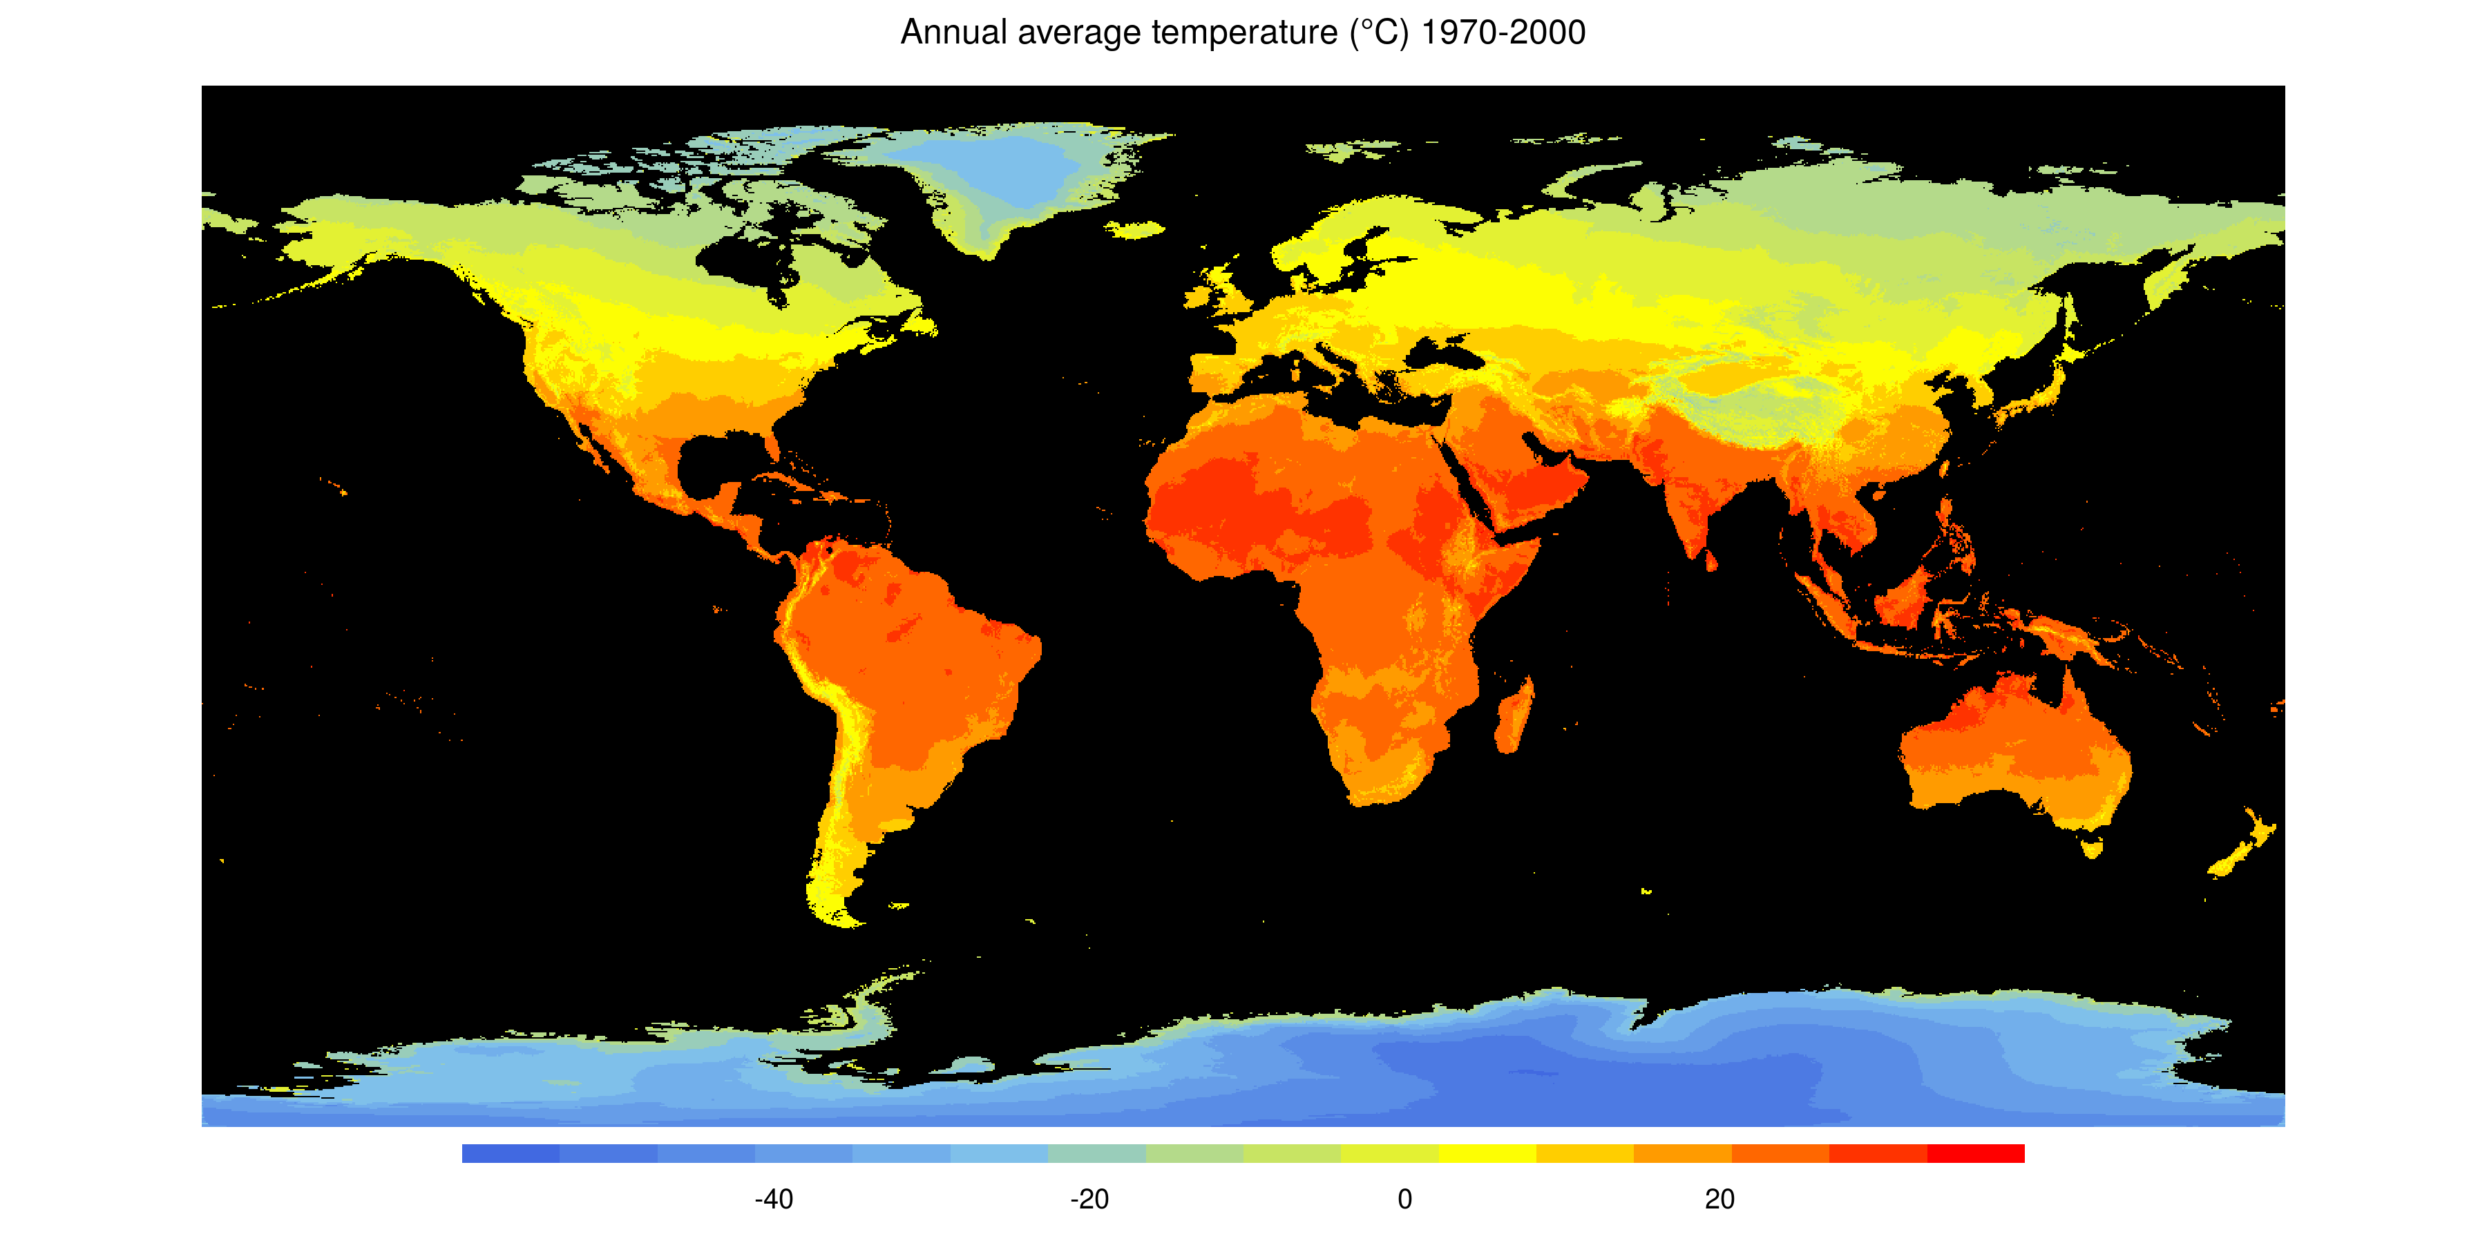
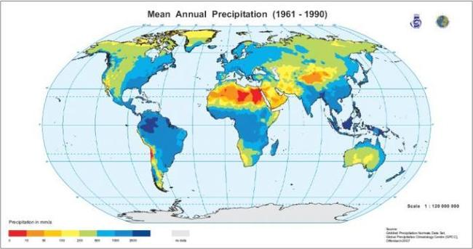
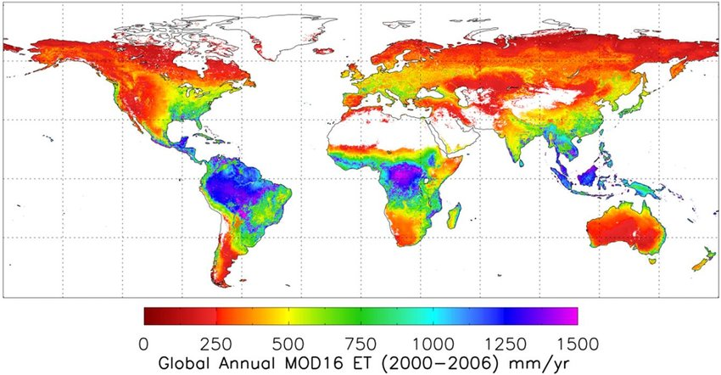
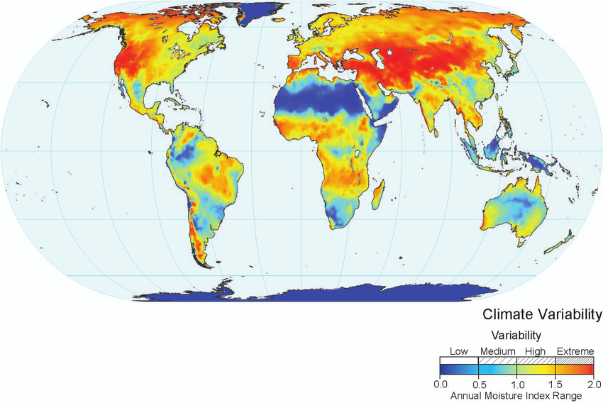
Temperature, precipitation, evapotranspiration, variability (seasonality)
Notes:
In this panel we can probably all agree that biodiversity is one of the most valuable natural resources.
But things like climate change or habitat loss are a threat to biodiversity, to the extent that we hear about biodiversity crisis, or sixth mass extinction
For example, about 1% of vertebrate species have gone extinct because of humans

Slide 19
Evapotranspiration – a proxy for energy input
Global species richness of birds
Hawkins et al. (2003) Ecology
Notes:
In this panel we can probably all agree that biodiversity is one of the most valuable natural resources.
But things like climate change or habitat loss are a threat to biodiversity, to the extent that we hear about biodiversity crisis, or sixth mass extinction
For example, about 1% of vertebrate species have gone extinct because of humans

Slide 20
Evapotranspiration – a proxy for energy input
Hawkins et al. (2003) Ecology
Notes:
In this panel we can probably all agree that biodiversity is one of the most valuable natural resources.
But things like climate change or habitat loss are a threat to biodiversity, to the extent that we hear about biodiversity crisis, or sixth mass extinction
For example, about 1% of vertebrate species have gone extinct because of humans

Slide 21
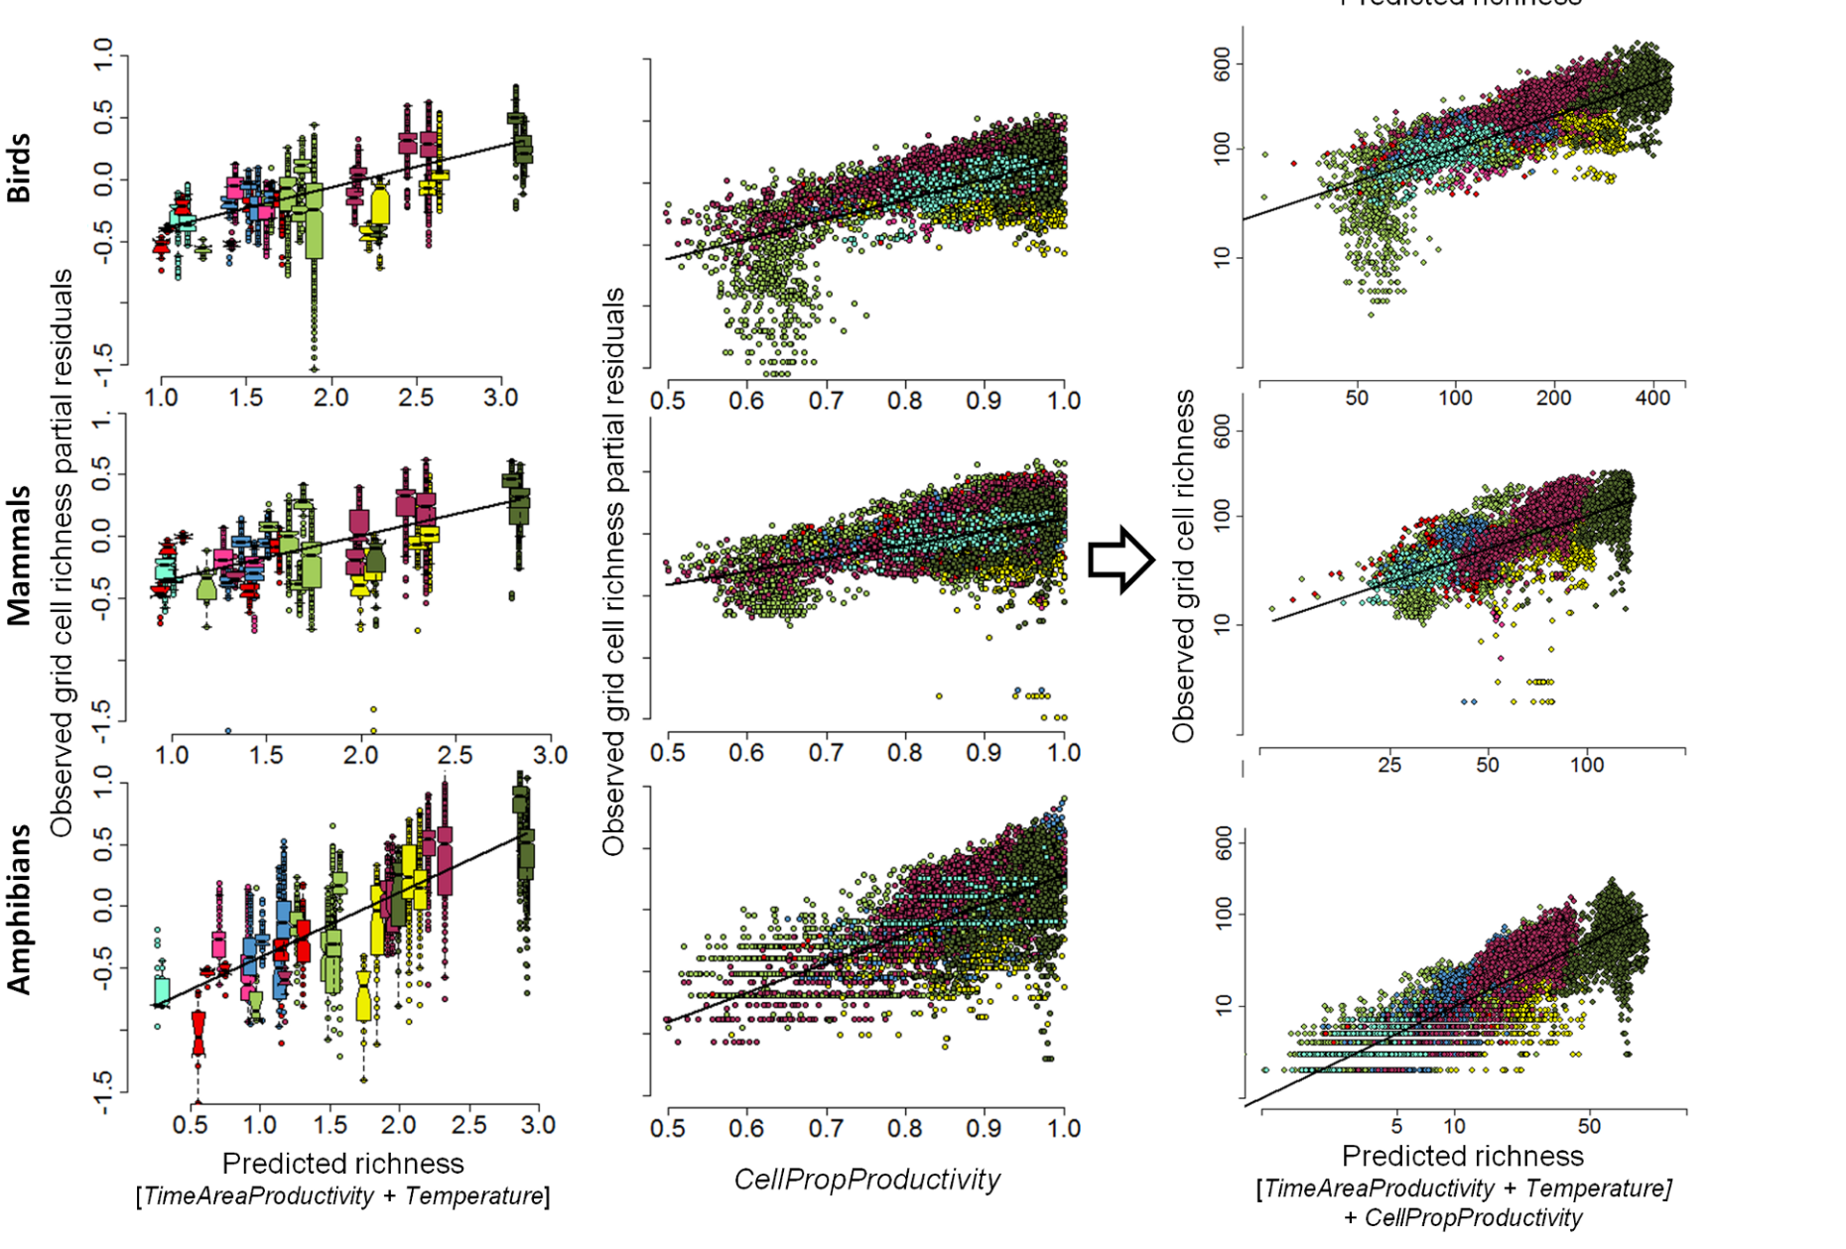
Net Primary Productivity
Jetz & Fine (2012) PLoS Biology
Notes:
In this panel we can probably all agree that biodiversity is one of the most valuable natural resources.
But things like climate change or habitat loss are a threat to biodiversity, to the extent that we hear about biodiversity crisis, or sixth mass extinction
For example, about 1% of vertebrate species have gone extinct because of humans

Slide 22
More individuals hypothesis
Storch et al. (2019) Ecology Letters
Notes:
In this panel we can probably all agree that biodiversity is one of the most valuable natural resources.
But things like climate change or habitat loss are a threat to biodiversity, to the extent that we hear about biodiversity crisis, or sixth mass extinction
For example, about 1% of vertebrate species have gone extinct because of humans

Slide 23
Rohde’s hypothesis
Warmer areas:
-> faster reactions -> more mutations -> faster speciation
or
-> faster generation times -> faster speciation
Rohde (1992) Oikos
Notes:
In this panel we can probably all agree that biodiversity is one of the most valuable natural resources.
But things like climate change or habitat loss are a threat to biodiversity, to the extent that we hear about biodiversity crisis, or sixth mass extinction
For example, about 1% of vertebrate species have gone extinct because of humans

Slide 24
Metabolic theory – faster metabolism, faster evolution
Simova et al. (2011) Global Ecology and Biogeography
Notes:
In this panel we can probably all agree that biodiversity is one of the most valuable natural resources.
But things like climate change or habitat loss are a threat to biodiversity, to the extent that we hear about biodiversity crisis, or sixth mass extinction
For example, about 1% of vertebrate species have gone extinct because of humans

Slide 25
Metabolic theory – faster metabolism, faster evolution
Allen et al. (2002) Science
Notes:
In this panel we can probably all agree that biodiversity is one of the most valuable natural resources.
But things like climate change or habitat loss are a threat to biodiversity, to the extent that we hear about biodiversity crisis, or sixth mass extinction
For example, about 1% of vertebrate species have gone extinct because of humans

Slide 26
Climatic limits
Simova et al. (2011) Global Ecology and Biogeography
Notes:
In this panel we can probably all agree that biodiversity is one of the most valuable natural resources.
But things like climate change or habitat loss are a threat to biodiversity, to the extent that we hear about biodiversity crisis, or sixth mass extinction
For example, about 1% of vertebrate species have gone extinct because of humans

Slide 27
Climatic limits
Simova et al. (2011) Global Ecology and Biogeography
Notes:
In this panel we can probably all agree that biodiversity is one of the most valuable natural resources.
But things like climate change or habitat loss are a threat to biodiversity, to the extent that we hear about biodiversity crisis, or sixth mass extinction
For example, about 1% of vertebrate species have gone extinct because of humans

Slide 28
Climate - summary
Simova et al. (2011) Global Ecology and Biogeography
Notes:
In this panel we can probably all agree that biodiversity is one of the most valuable natural resources.
But things like climate change or habitat loss are a threat to biodiversity, to the extent that we hear about biodiversity crisis, or sixth mass extinction
For example, about 1% of vertebrate species have gone extinct because of humans

Slide 29
3. Environmental heterogeneity
More habitats, more species?
Notes:
I am qualified to deliver all this

Slide 30
Empirical support – a global meta-analysis
Stein, Gerstner & Kreft (2014) Ecology Letters
Notes:
In this panel we can probably all agree that biodiversity is one of the most valuable natural resources.
But things like climate change or habitat loss are a threat to biodiversity, to the extent that we hear about biodiversity crisis, or sixth mass extinction
For example, about 1% of vertebrate species have gone extinct because of humans

Slide 31
Empirical support – a global meta-analysis
Stein, Gerstner & Kreft (2014) Ecology Letters
Notes:
In this panel we can probably all agree that biodiversity is one of the most valuable natural resources.
But things like climate change or habitat loss are a threat to biodiversity, to the extent that we hear about biodiversity crisis, or sixth mass extinction
For example, about 1% of vertebrate species have gone extinct because of humans

Slide 32
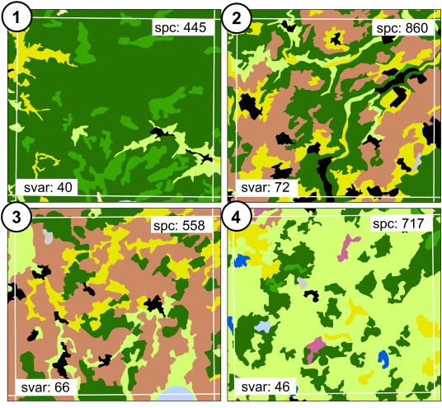
Spectral variability hypothesis
Rocchini et al. (2010) Ecol. Informatics
Féret & Asner (2011) Rem. Sens. Environ.
Notes:
In this panel we can probably all agree that biodiversity is one of the most valuable natural resources.
But things like climate change or habitat loss are a threat to biodiversity, to the extent that we hear about biodiversity crisis, or sixth mass extinction
For example, about 1% of vertebrate species have gone extinct because of humans

Slide 33
4. Dispersal limits, history, evolution
Notes:
I am qualified to deliver all this

Slide 34
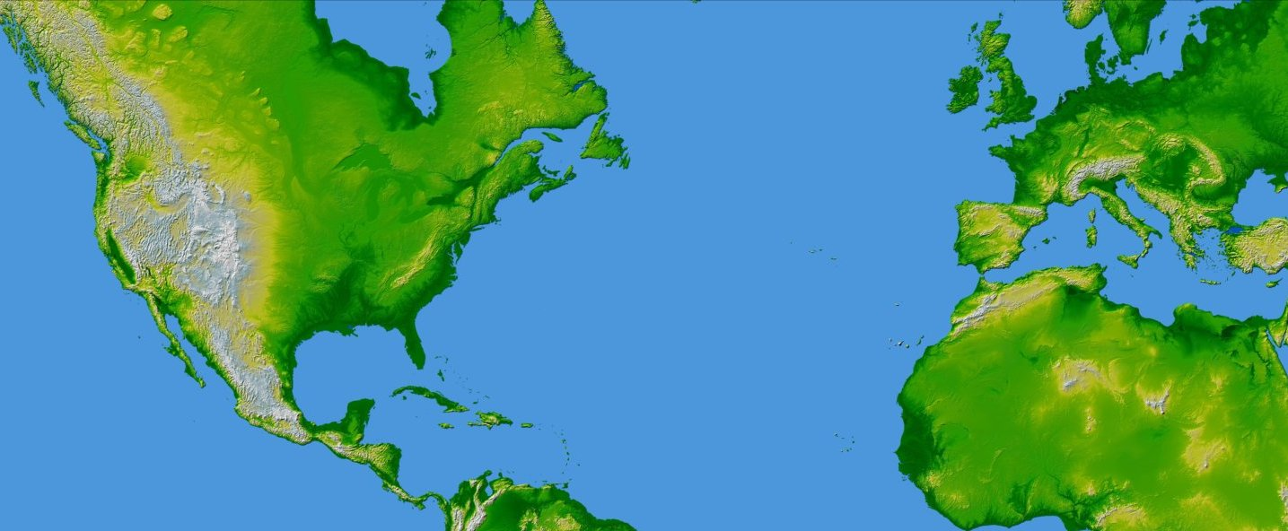
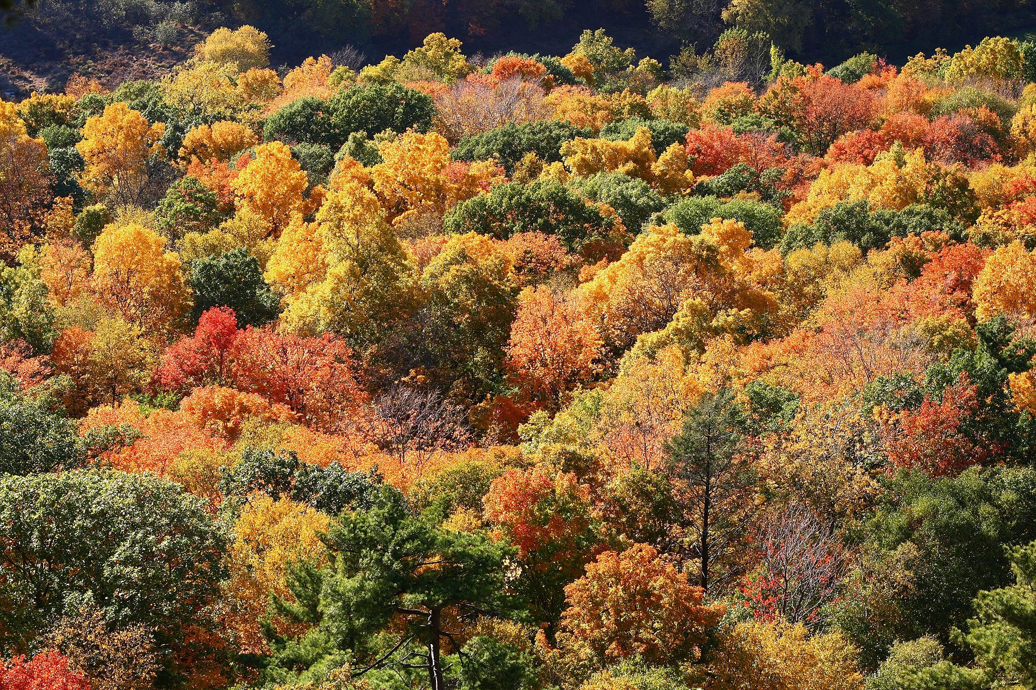
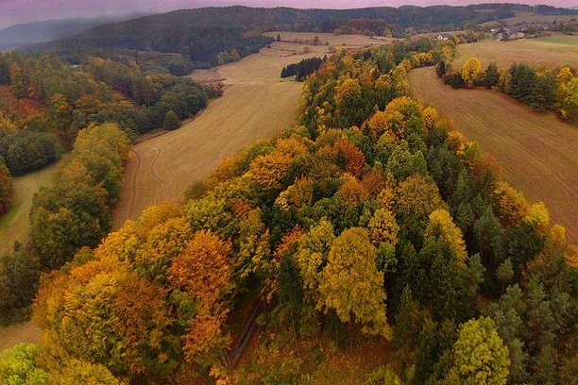
Dispersal limits
X
Connecticut, USA
Czech Republic, EU
Ricklefs & Schluter (1993), Keil & Chase (2019) Nature Ecology & Evolution
map from NASA (public domain)
Notes:
In this panel we can probably all agree that biodiversity is one of the most valuable natural resources.
But things like climate change or habitat loss are a threat to biodiversity, to the extent that we hear about biodiversity crisis, or sixth mass extinction
For example, about 1% of vertebrate species have gone extinct because of humans

Slide 35
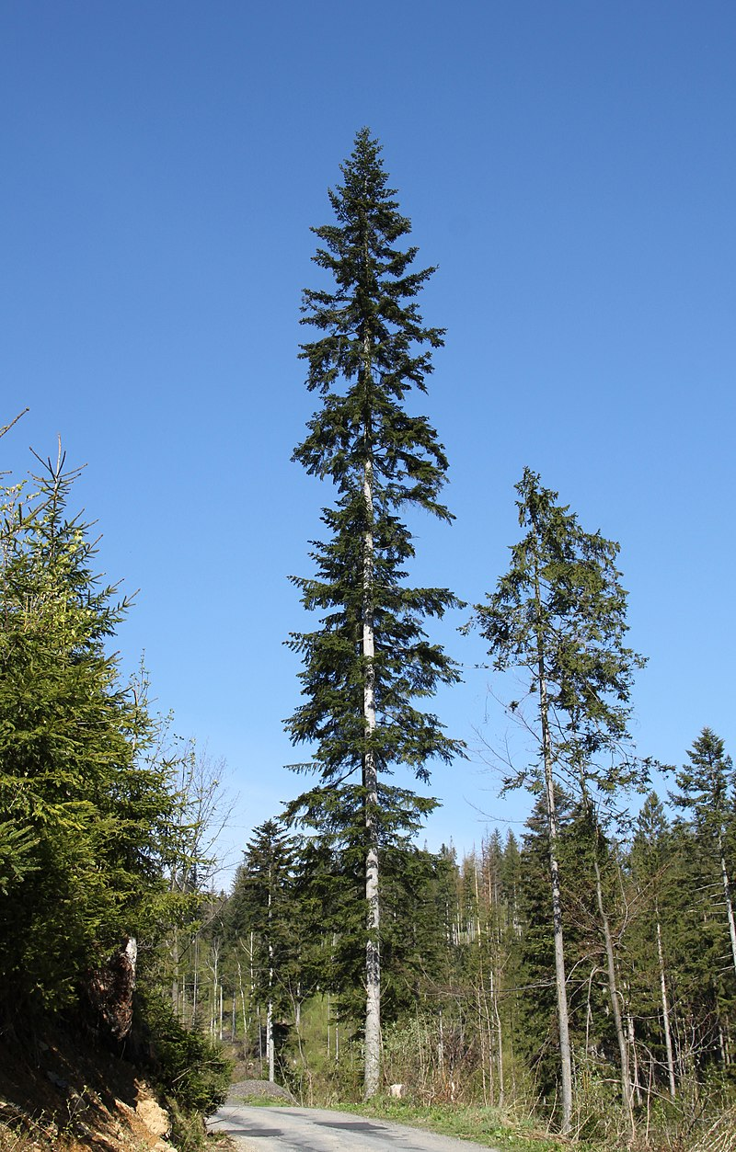
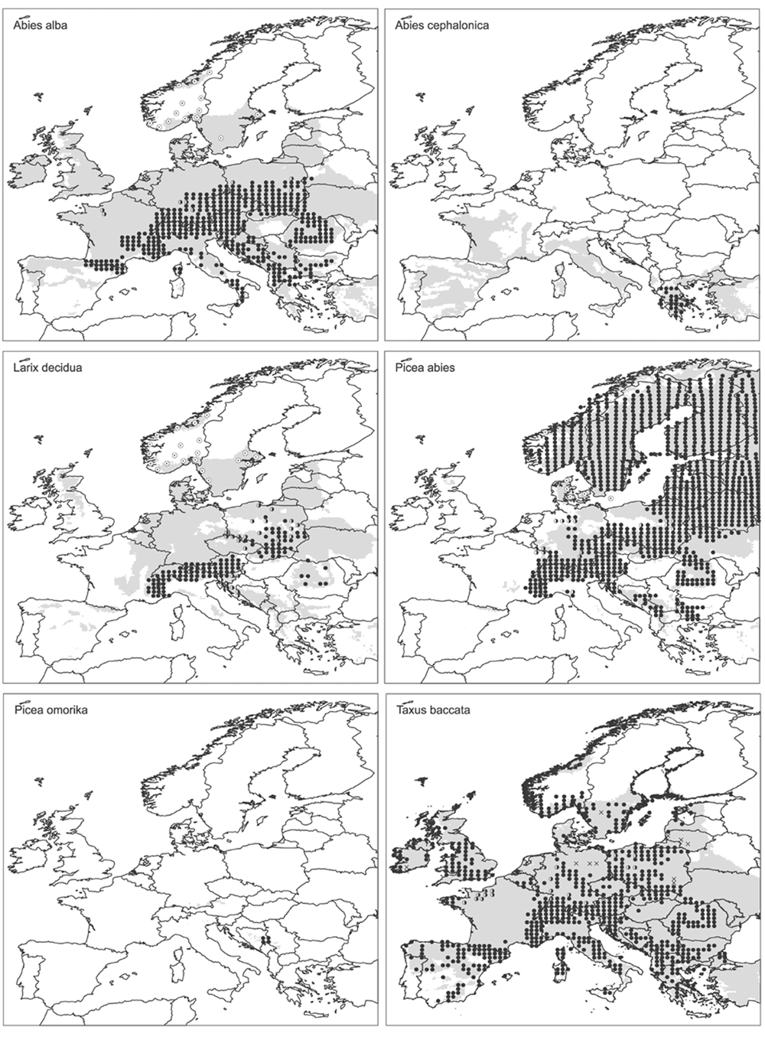
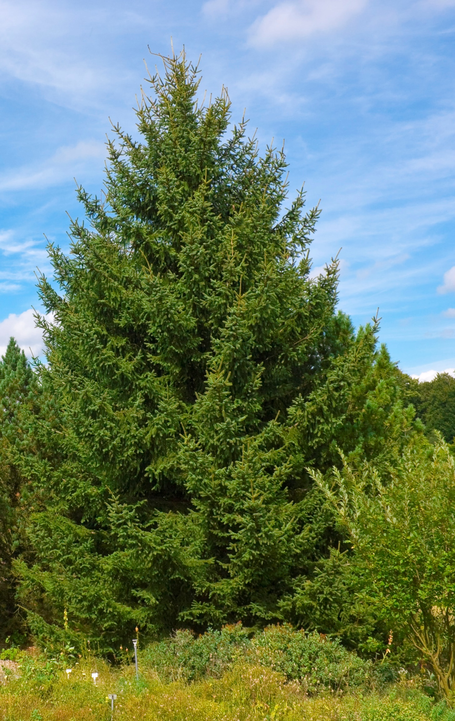
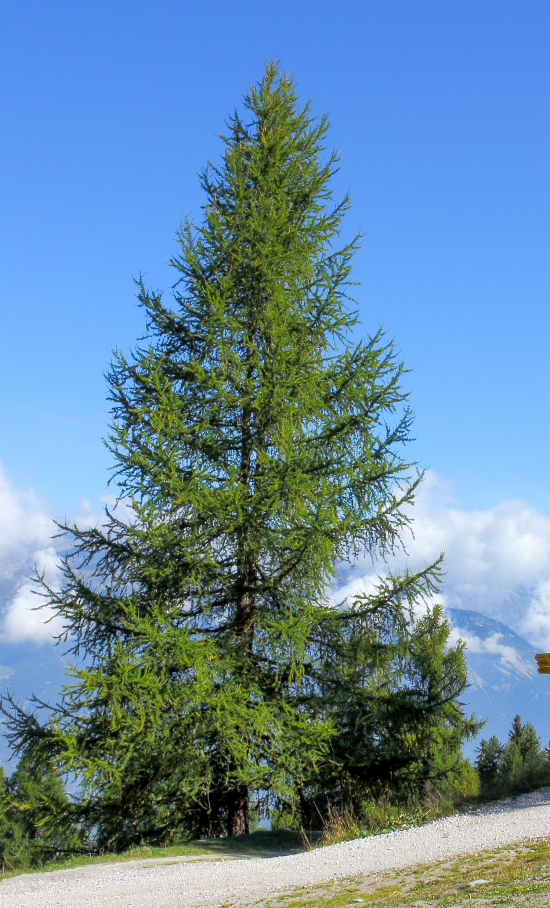
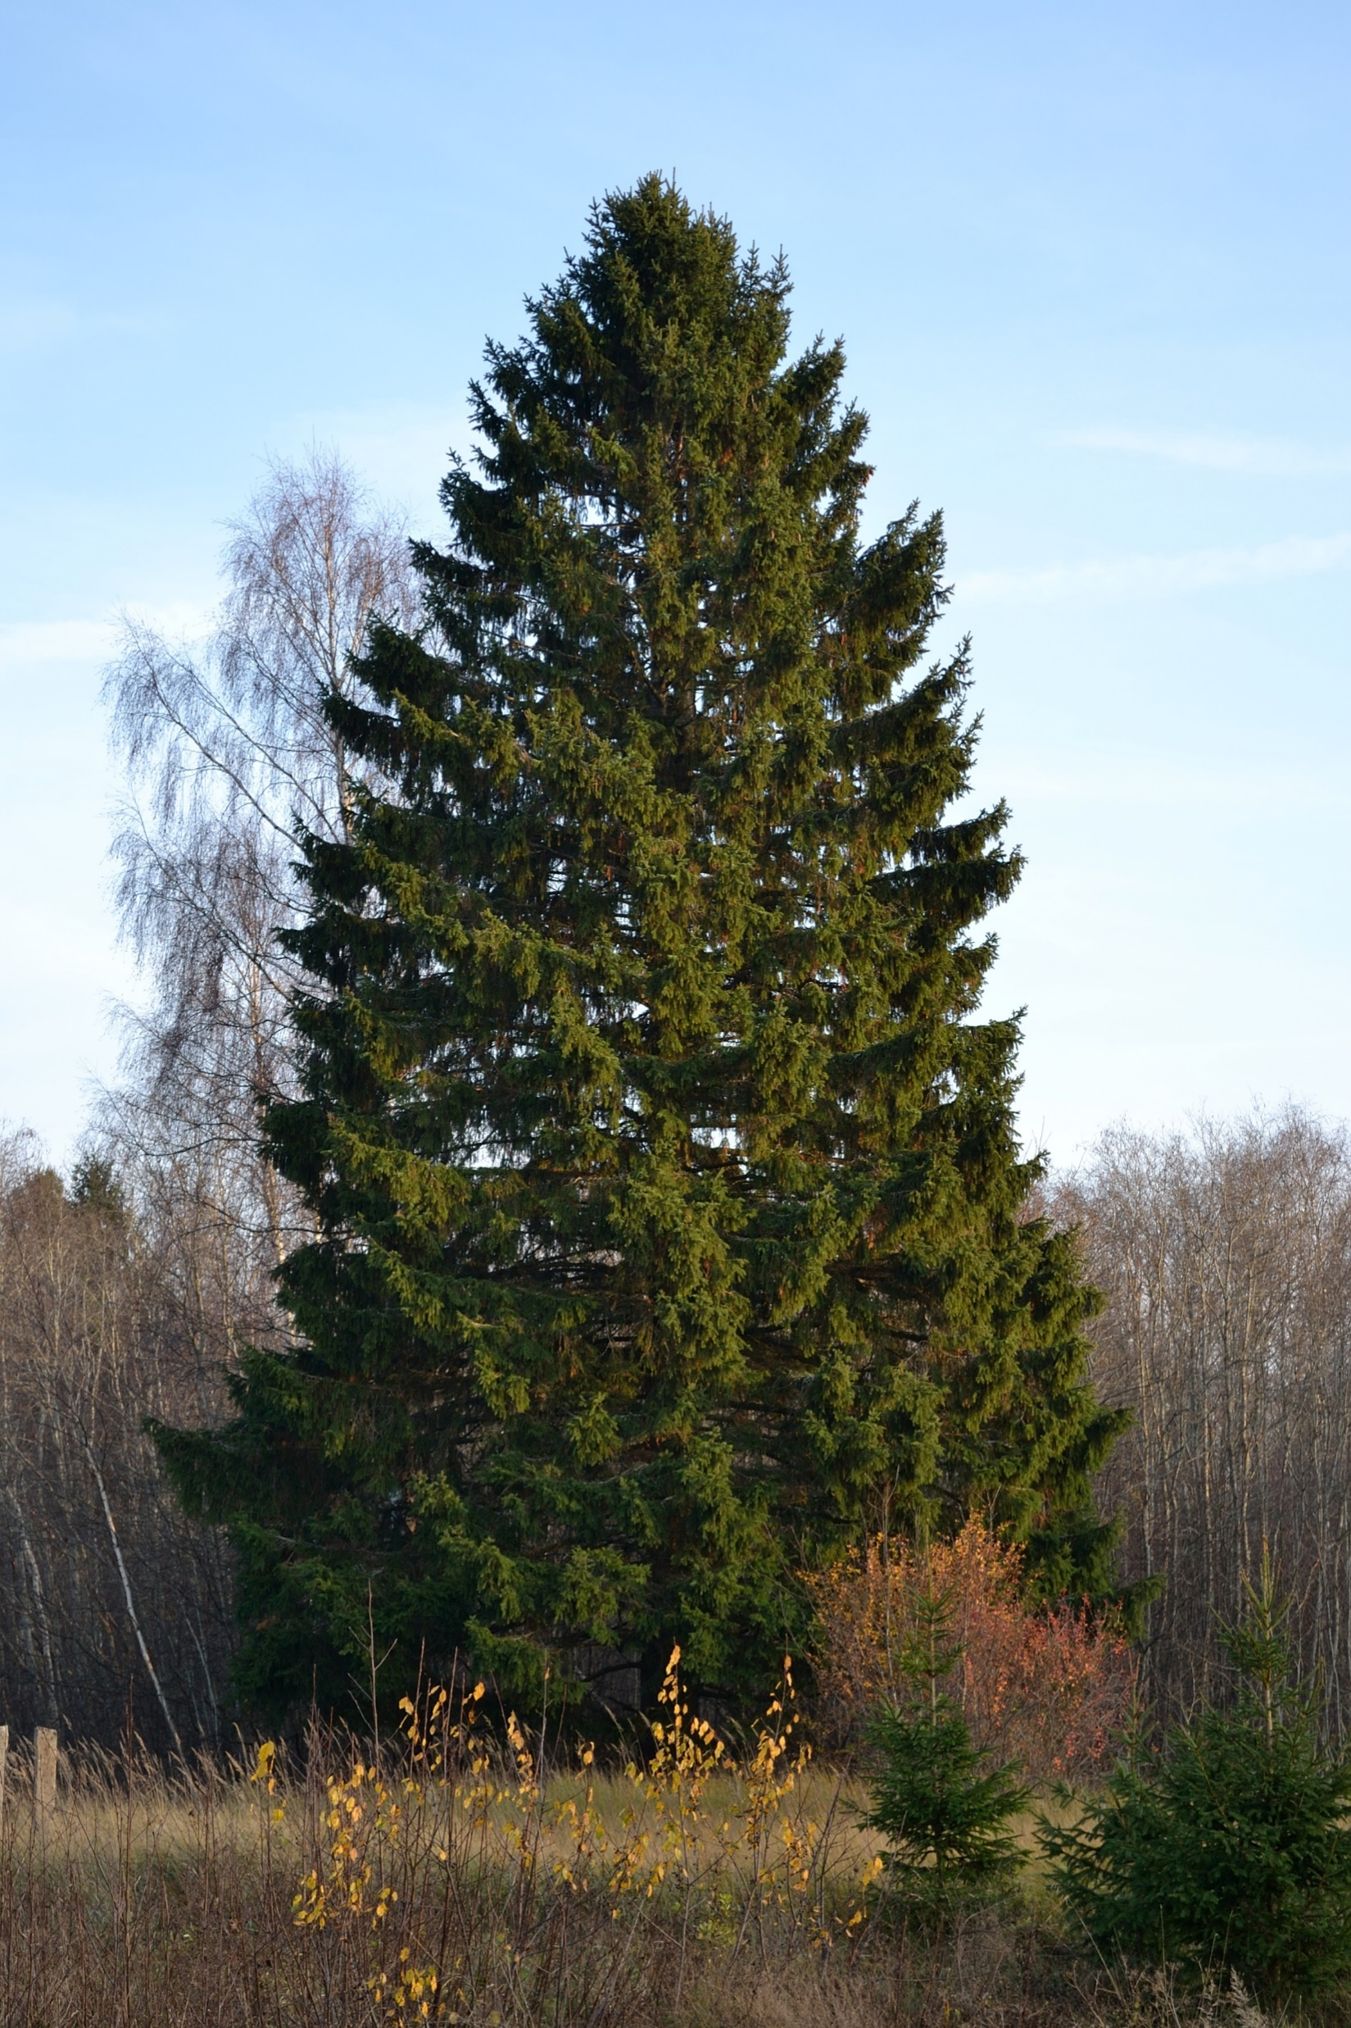
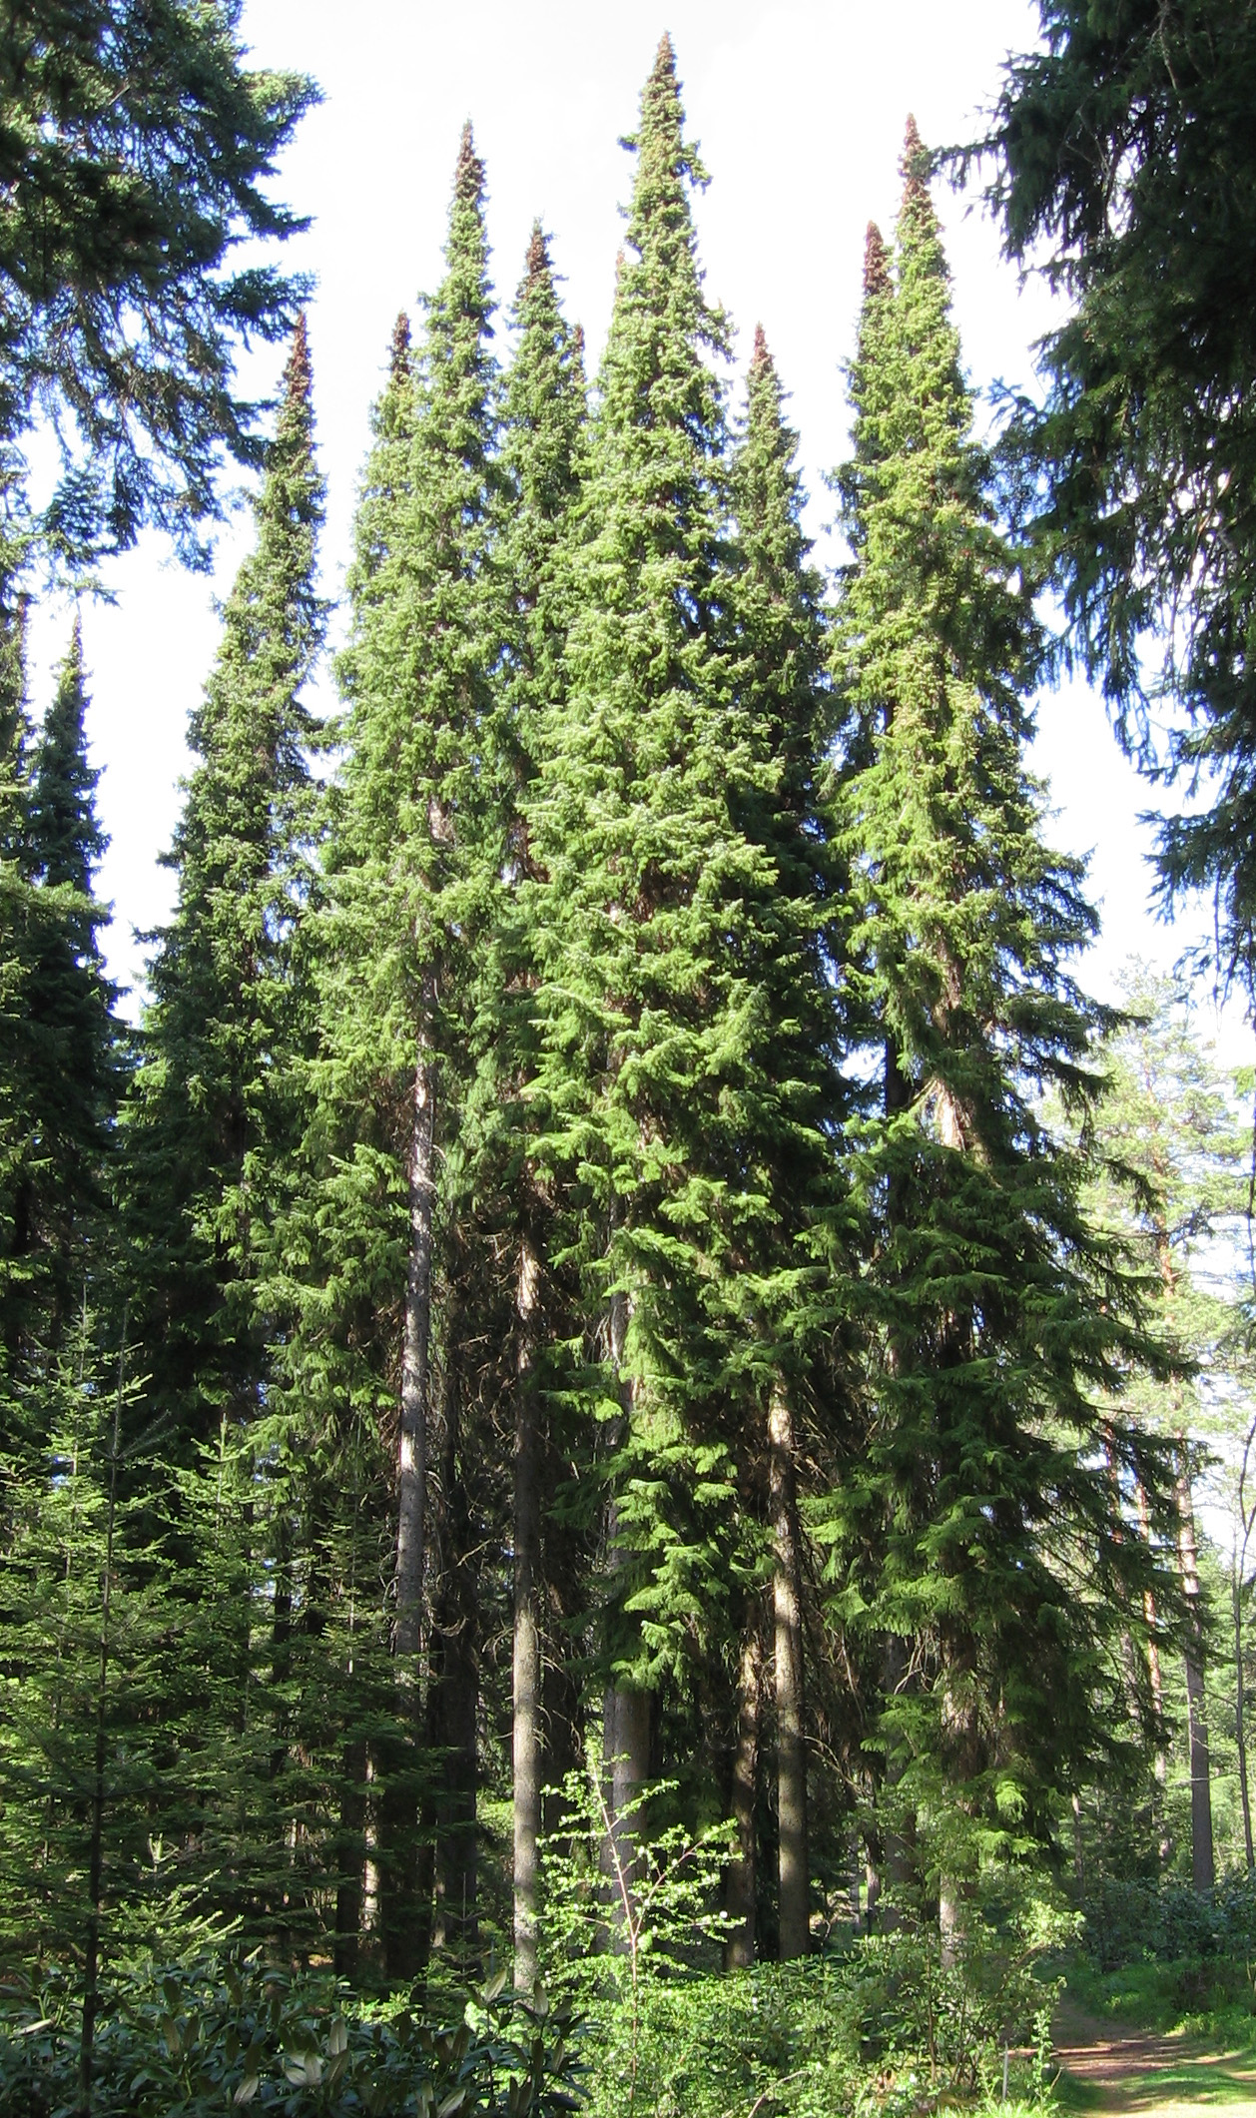
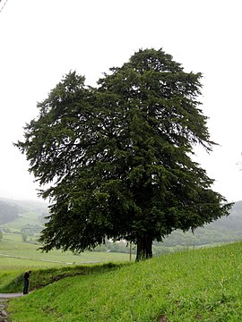
Dispersal limits
Svenning & Skov (2004) Ecology Letters
Notes:
In this panel we can probably all agree that biodiversity is one of the most valuable natural resources.
But things like climate change or habitat loss are a threat to biodiversity, to the extent that we hear about biodiversity crisis, or sixth mass extinction
For example, about 1% of vertebrate species have gone extinct because of humans

Slide 36
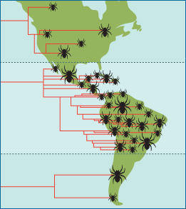
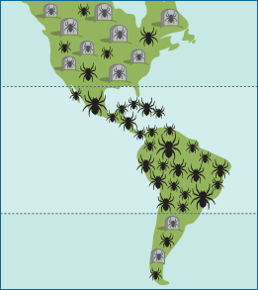
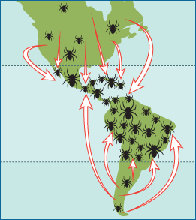
Tropics as cradle, or museum of biodiversity
Tropics as a
cradle of biodiversity
Tropics as a
museum of biodiversity
Tropics as a
destination of biodiversity
= higher speciation in the tropics
= lower extinciton in the tropics
evolution.berkeley.edu
Notes:
In this panel we can probably all agree that biodiversity is one of the most valuable natural resources.
But things like climate change or habitat loss are a threat to biodiversity, to the extent that we hear about biodiversity crisis, or sixth mass extinction
For example, about 1% of vertebrate species have gone extinct because of humans

Slide 37
Tropics as cradle, or museum of biodiversity
Rangel et al. (2018) Science
https://players.brightcove.net/53038991001/default_default/index.html?videoId=5810230822001
Notes:
In this panel we can probably all agree that biodiversity is one of the most valuable natural resources.
But things like climate change or habitat loss are a threat to biodiversity, to the extent that we hear about biodiversity crisis, or sixth mass extinction
For example, about 1% of vertebrate species have gone extinct because of humans

Slide 38
Synthesis?
… and the role of scale in all this
Notes:
I am qualified to deliver all this

Slide 39
Broadly, there is empirical support for most of these hypotheses
But … climatic drivers are most common.
Climate
Edaphic
Interacitons
Heterogeneity
Area
Dispersal, history
Field et al. (2009) Journal of Biogeography
Notes:
In this panel we can probably all agree that biodiversity is one of the most valuable natural resources.
But things like climate change or habitat loss are a threat to biodiversity, to the extent that we hear about biodiversity crisis, or sixth mass extinction
For example, about 1% of vertebrate species have gone extinct because of humans

Slide 40
And it is also all dependent on spatial grain
Field et al. (2009) Journal of Biogeography
Notes:
In this panel we can probably all agree that biodiversity is one of the most valuable natural resources.
But things like climate change or habitat loss are a threat to biodiversity, to the extent that we hear about biodiversity crisis, or sixth mass extinction
For example, about 1% of vertebrate species have gone extinct because of humans

Slide 41
And there is the problem of collinearity
Keil & Chase (2019) Nature Ecology and Evolution
Notes:
In this panel we can probably all agree that biodiversity is one of the most valuable natural resources.
But things like climate change or habitat loss are a threat to biodiversity, to the extent that we hear about biodiversity crisis, or sixth mass extinction
For example, about 1% of vertebrate species have gone extinct because of humans

Slide 42
Altitudinal (elevation) gradients of biodiversity
From the sea level upwards
Notes:
I am qualified to deliver all this

Slide 43
Elevational gradient of species richness
On top of the usual suspects that apply for latitude (e.g. productivity):
Effect of area
UV radiation
Gravitation (water flows down)
Refugia
Quintero & Jetz (2018) Nature
Notes:
In this panel we can probably all agree that biodiversity is one of the most valuable natural resources.
But things like climate change or habitat loss are a threat to biodiversity, to the extent that we hear about biodiversity crisis, or sixth mass extinction
For example, about 1% of vertebrate species have gone extinct because of humans

Slide 44
Thank you. Questions?

